Slide 1

S&P 500 Data Analyses
By: Pythons that Byte

Slide 2
Members
Brady Buttrey
Siya Behl
Noah Vich
Lizette Ponce
Thieu Bui
Nicholas Milza

Slide 3
Q: Historically, what year had the highest interests rates, and how did that affect the S&P 500?

Slide 4
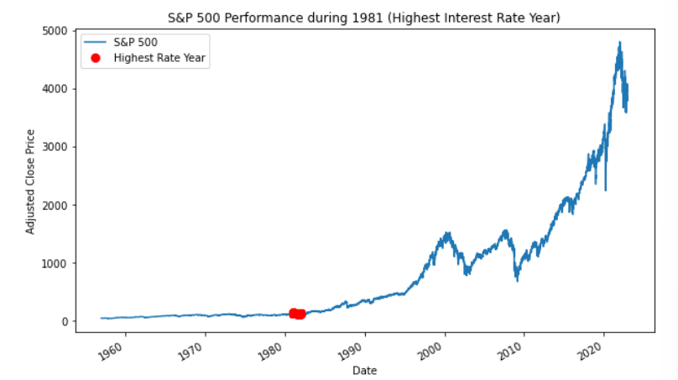
1981

Slide 5
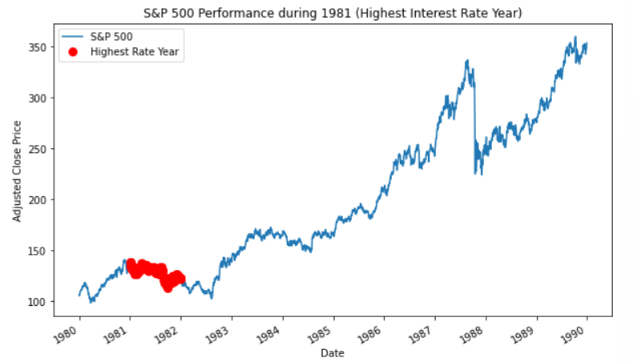
A closer look:

Slide 6
Q: Are there any noticeable trends in the S&P 500’s performance during the first 100 days of a new presidential administration?

Slide 7
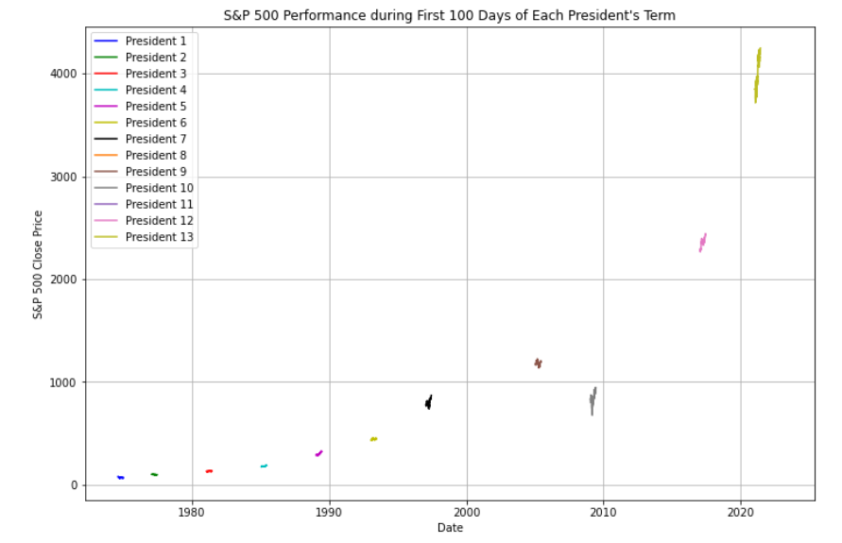

Slide 8
Q: Is there any correlation between the S&P 500 and GDP? If there is, is it negative or positive?

Slide 9
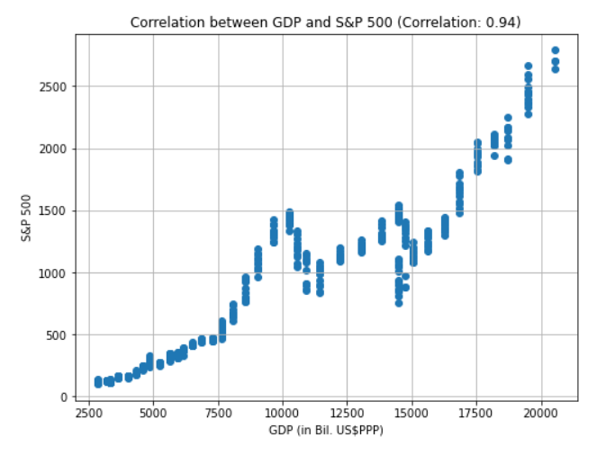

Slide 10
Q: Do presidential administration changes drastically affect the S&P 500?
Notes:
To build off of the previous presidential analysis, I wanted to focus more on the presidents and the S&P value during their term.

Slide 11
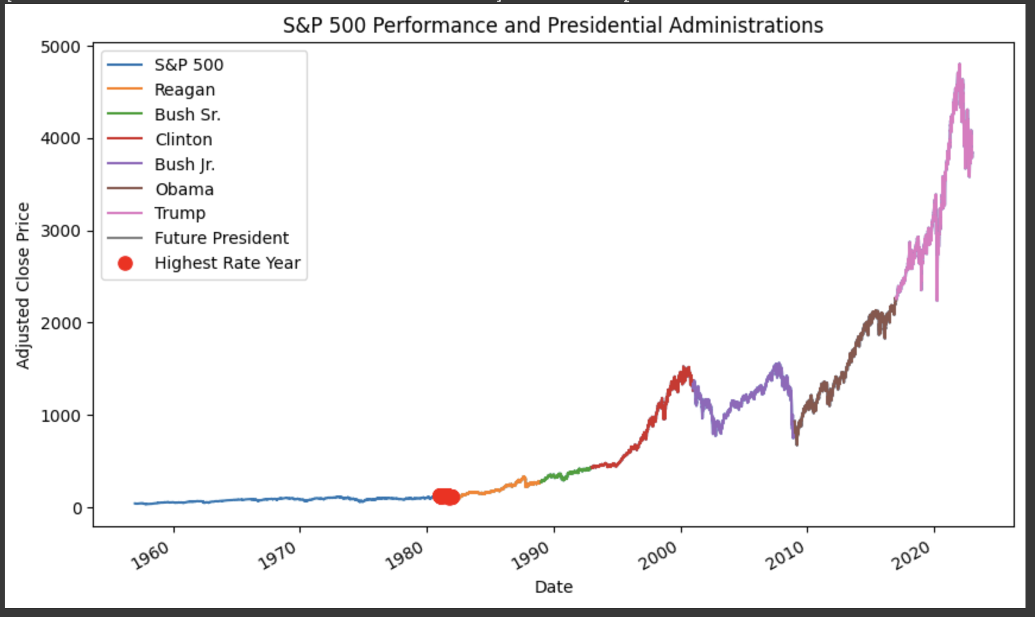

Slide 12
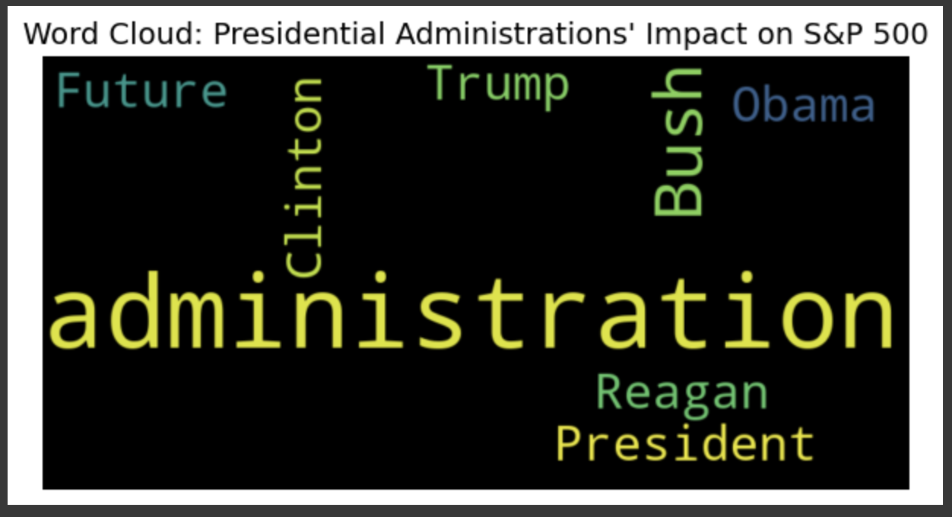

Slide 13
Q: What years were the best and the lowest in terms of the S&P 500’s value?

Slide 14
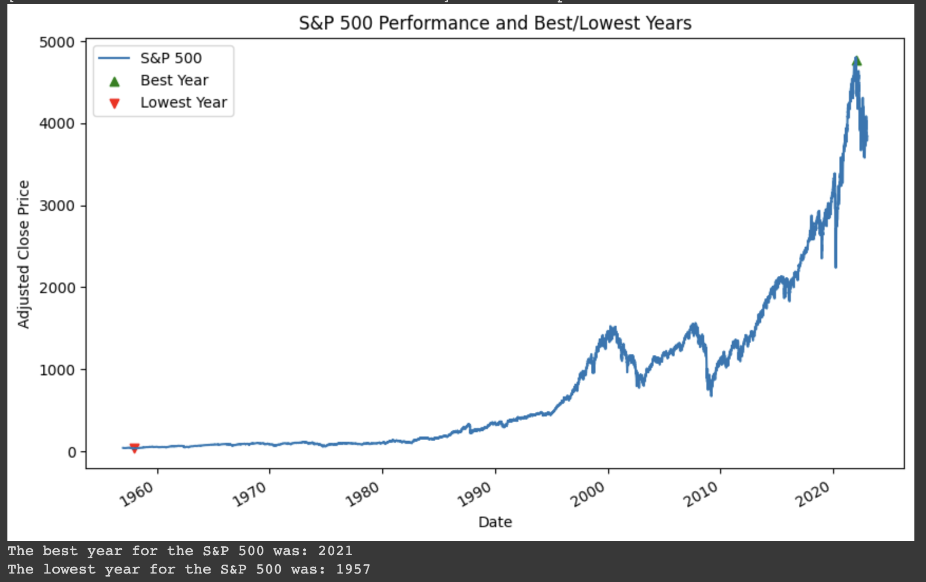

Slide 15
Q: Historically, what years have the worst yearly change percentage?

Slide 16
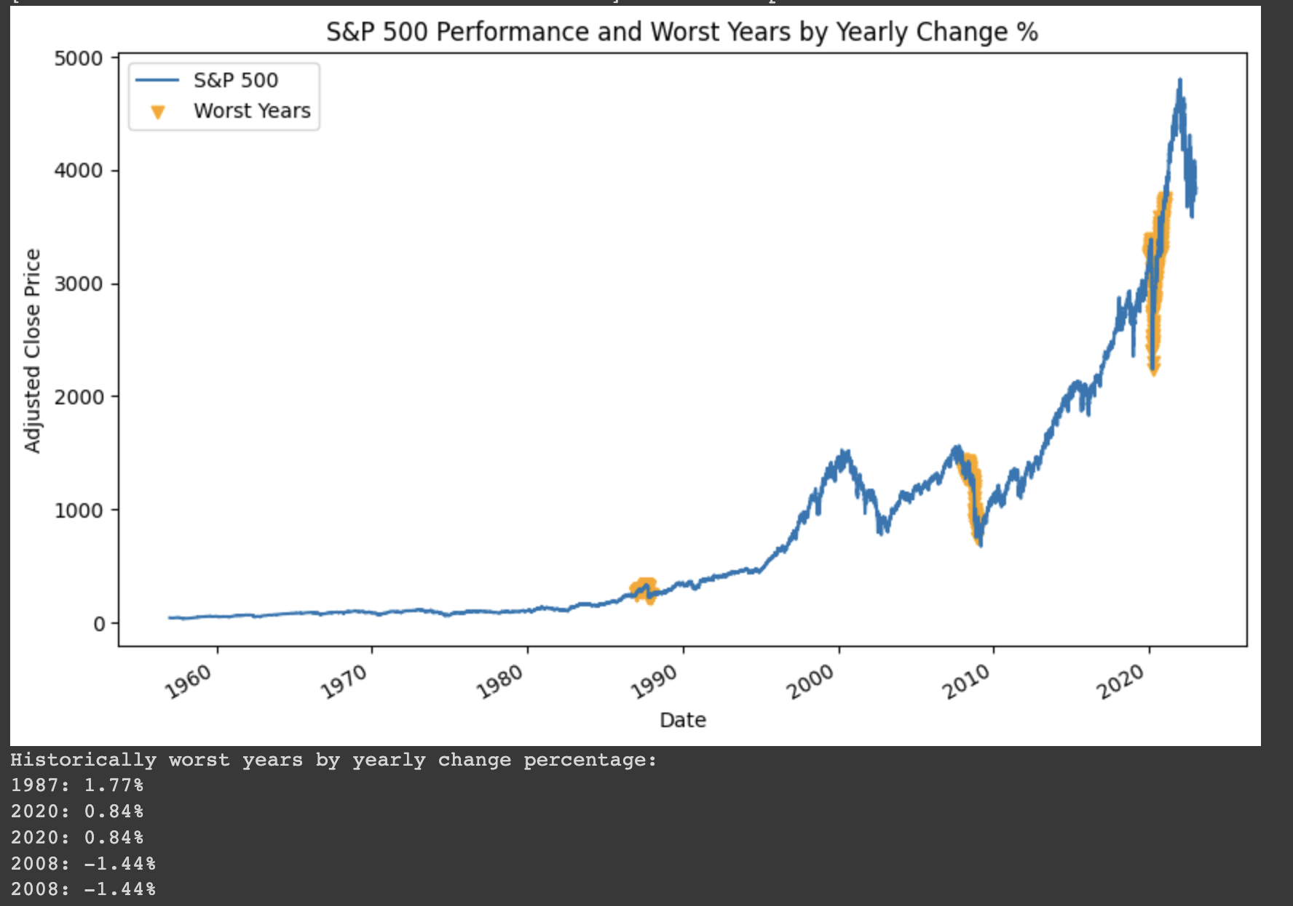

Slide 17
Q: How do the closing prices correlate with the S&P 500 Index?

Slide 18
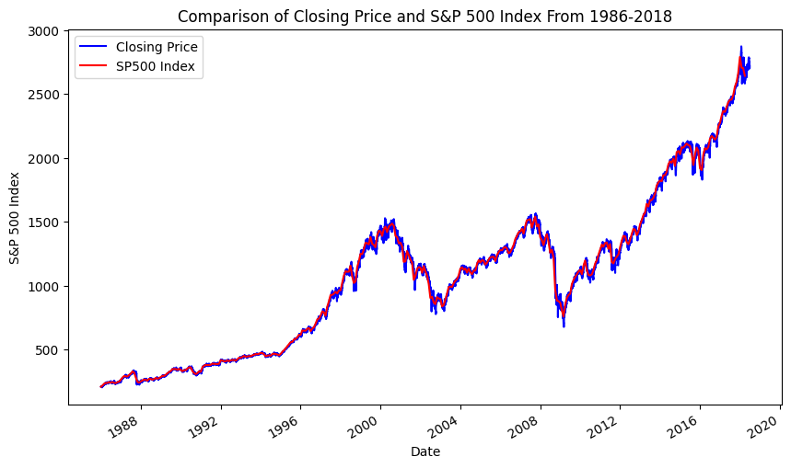

Slide 19
Q: How Does the S&P 500 Index Affect Market Phases?

Slide 20
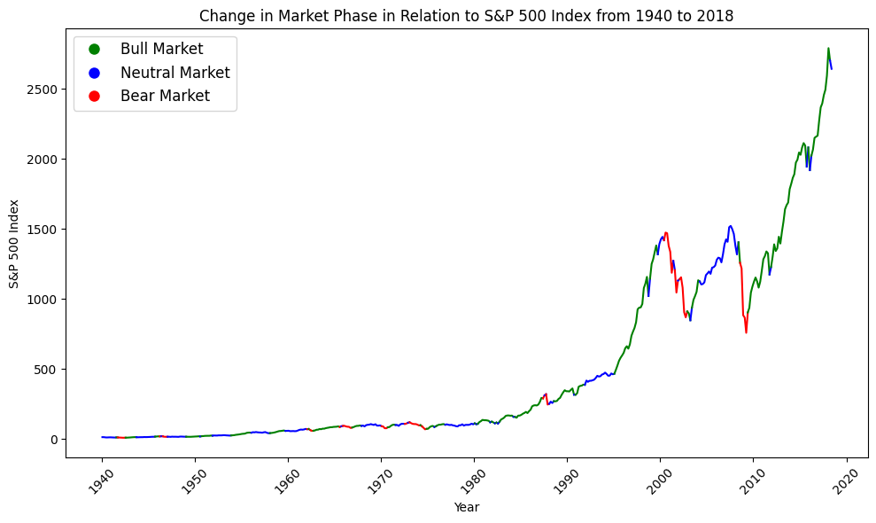

Slide 21
Q: How Do the Market Phases correlate with the CBOE Volatility Index?

Slide 22
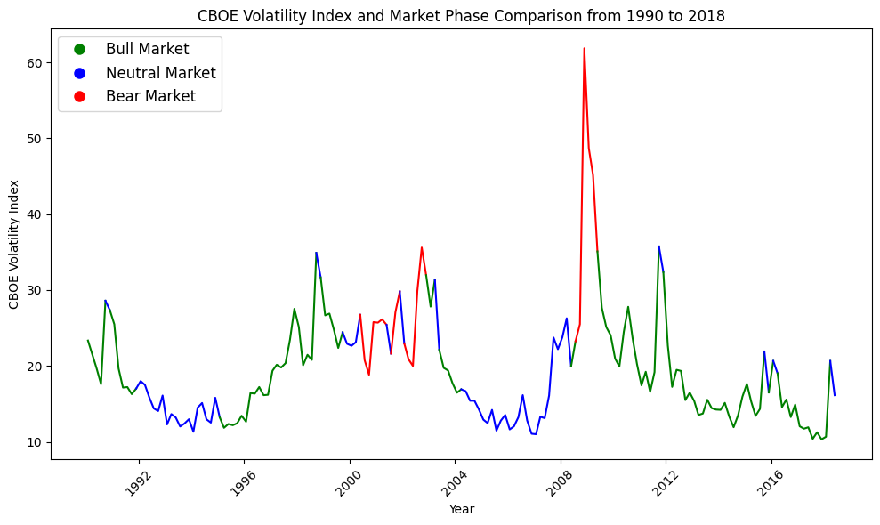

Slide 23
Q: What is the correlation between the CPI and S&P 500?

Slide 24
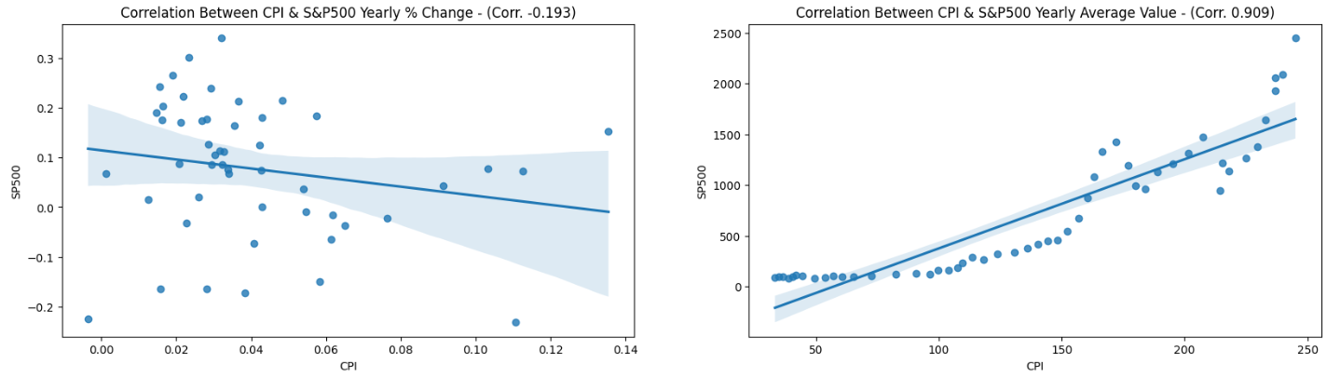
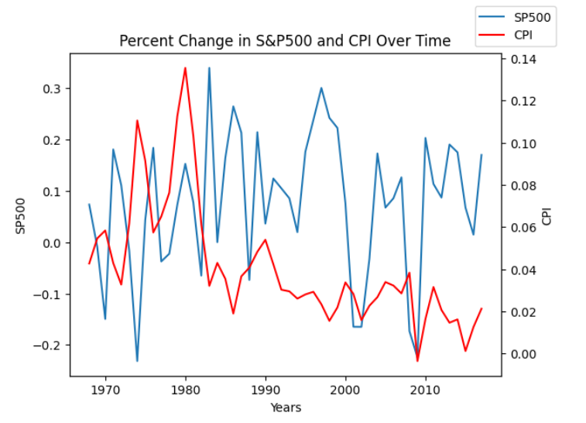
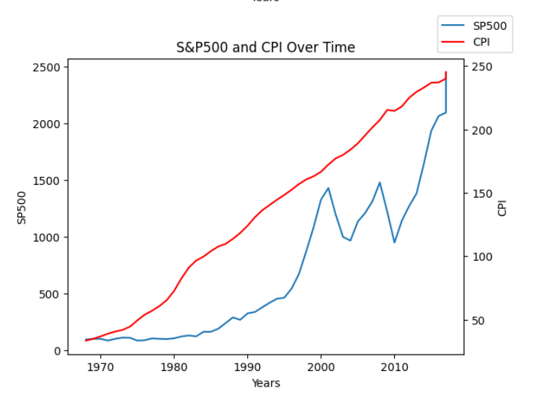

Slide 25
Q: What is the relationship between S&P 500 price action and GNP?

Slide 26
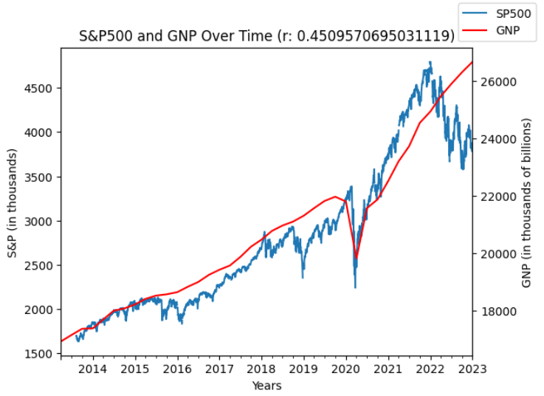
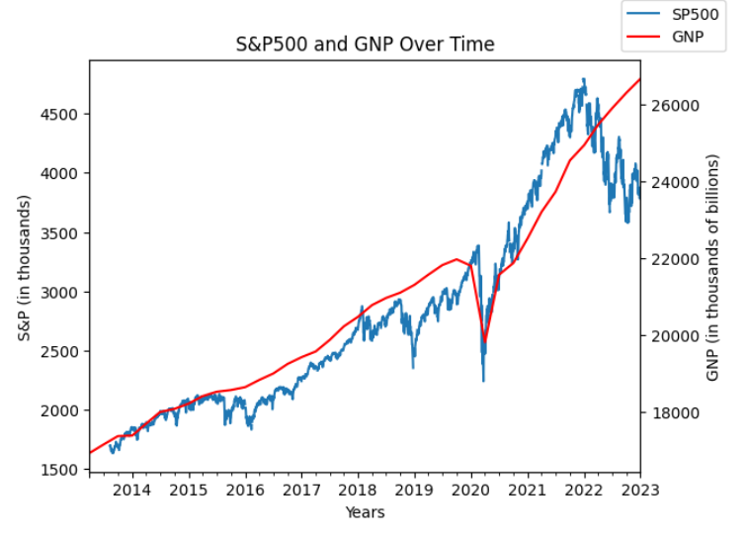

Slide 27
Q: What is the relationship between US Crude Oil FPP and S&P 500?
FPP = First Purchase Price

Slide 28
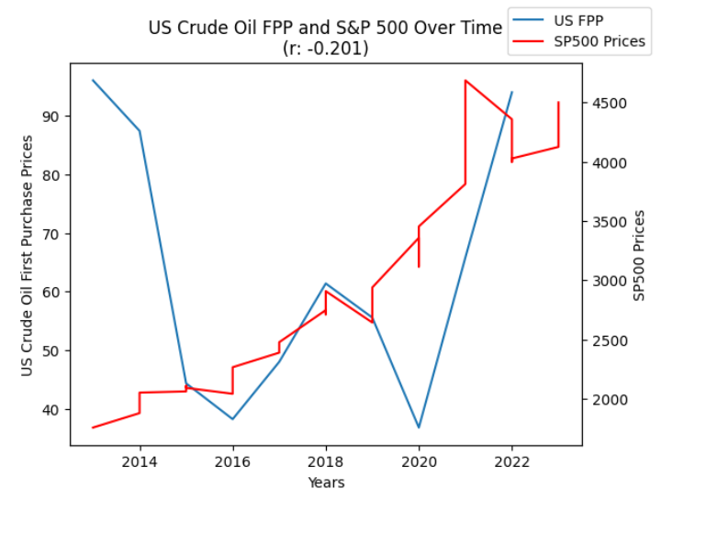
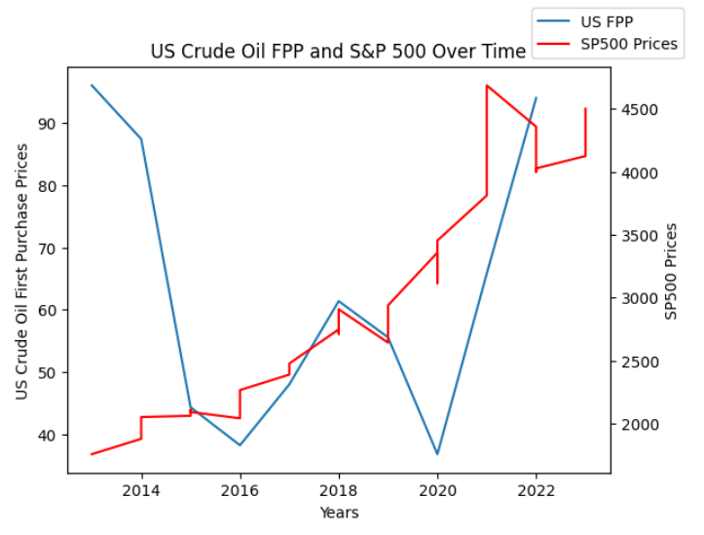

Slide 29
Q: How is the S&P 500 affected during times of protest such as the Occupy Wall Street Movement?

Slide 30
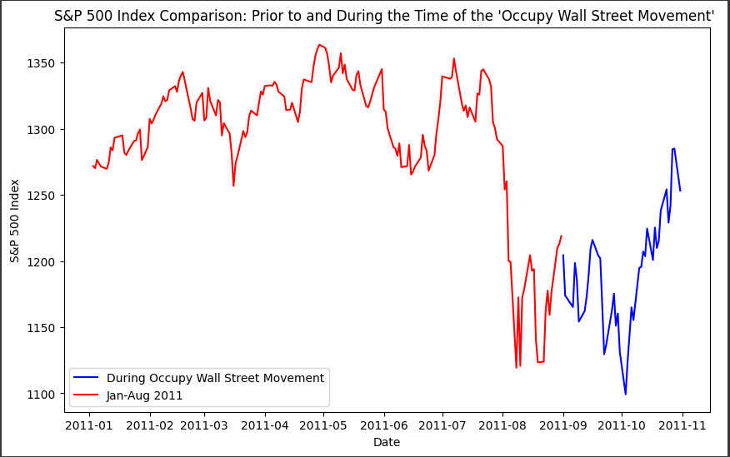

Slide 31
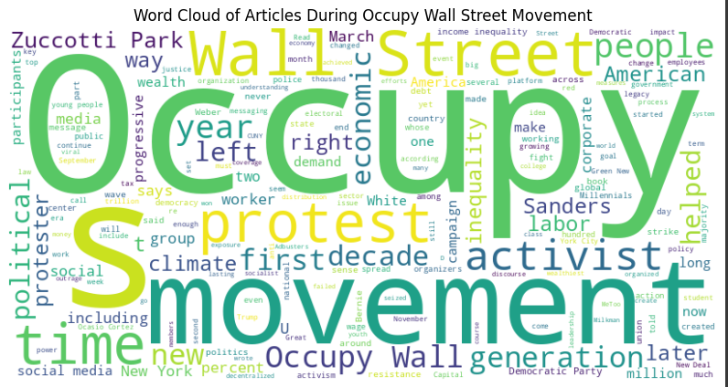

Slide 32
Q: How has the S&P 500 performed in recents times in comparison to how it’s performed historically?

Slide 33
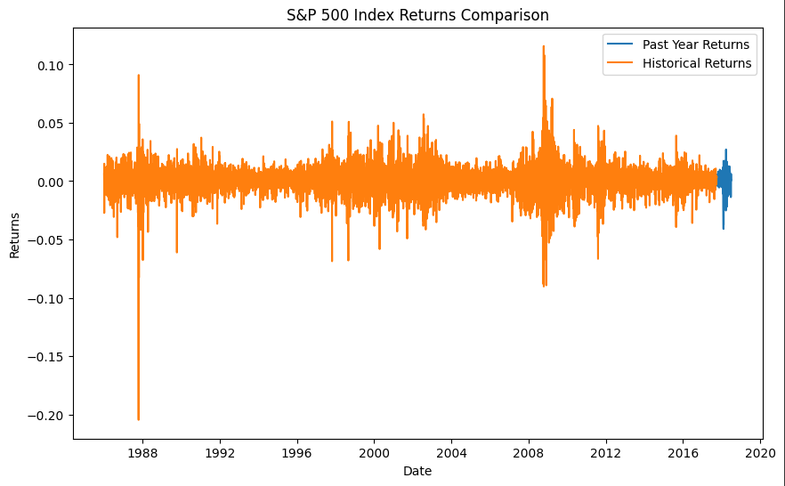

Slide 34
Q: What relationship is there with unemployment rates in the US and the S&P 500 index?

Slide 35
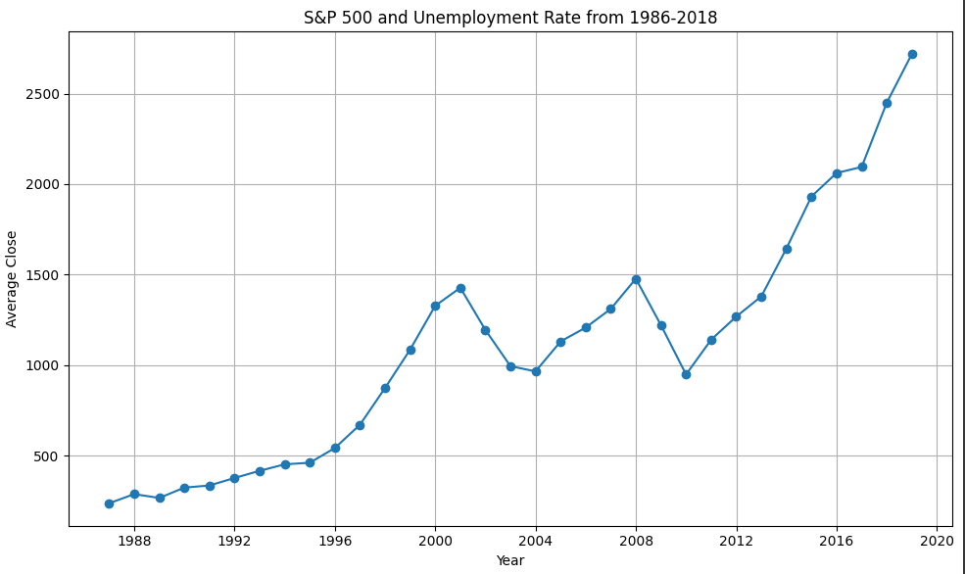
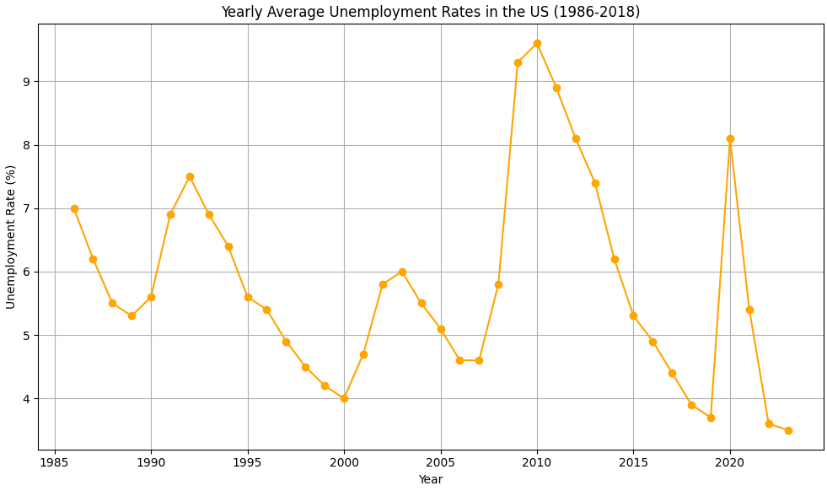

Slide 36
Q: Has there been a significant increase in the number of companies listed on the S&P 500 over the years?

Slide 37
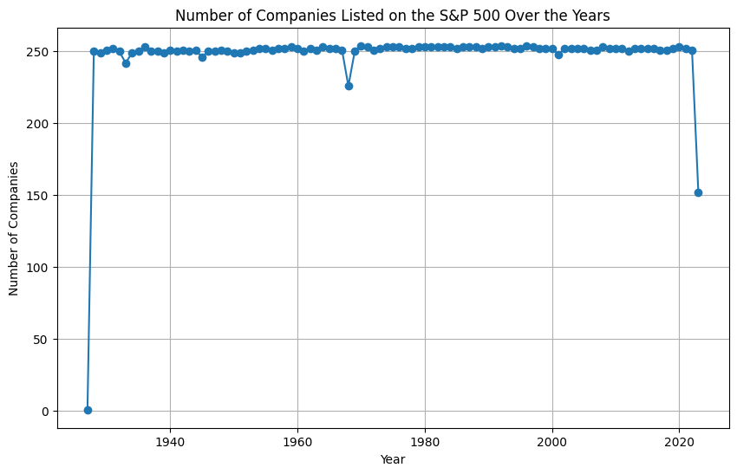
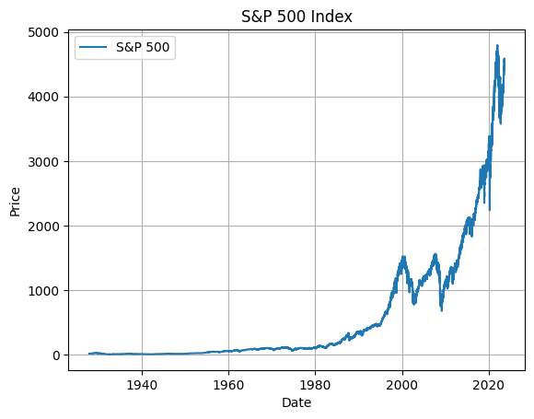

Slide 38
Q: What seem to be relevant to the S&P 500 index prices?

Slide 39
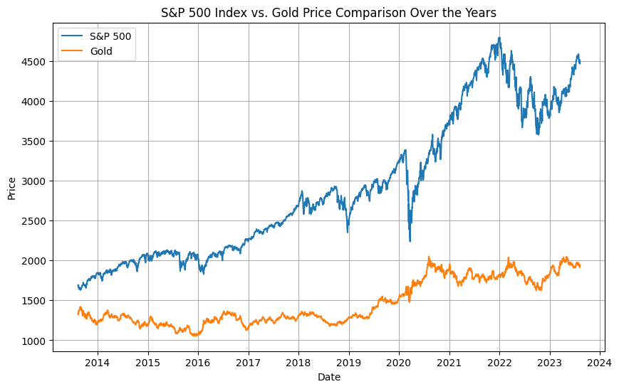
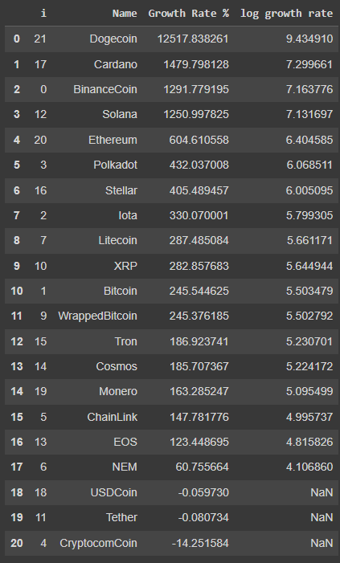
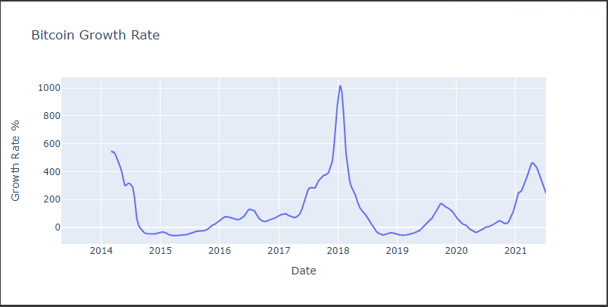

Slide 40
Q: Do crashes lead to significant changes in S&P prices?

Slide 41
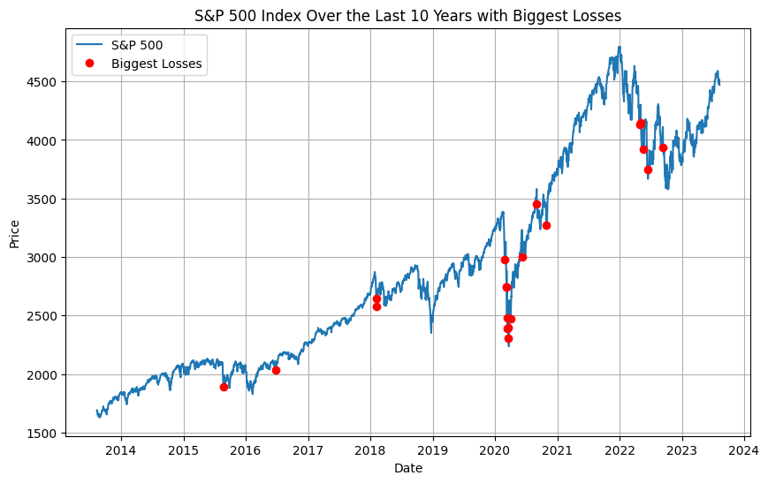

Slide 42
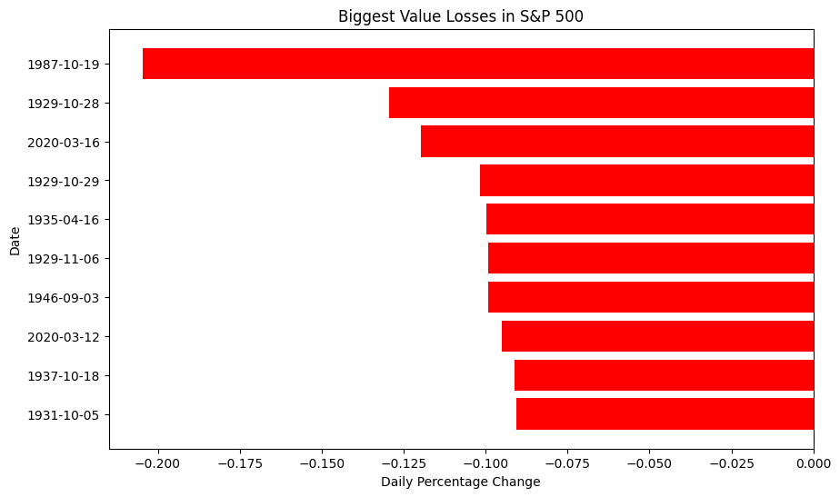

Slide 43
Sources
GDP Scraped Data: https://en.wikipedia.org/wiki/Economy_of_the_United_States#Data
US Crude Oil FPP: https://www.eia.gov/dnav/pet/hist/LeafHandler.ashx?n=pet&s=f000000__3&f=a
Kaggle data sets:
- https://www.kaggle.com/datasets/pdquant/sp500-daily-19862018
- https://www.kaggle.com/datasets/pdquant/sp500-daily-19862018
-https://www.kaggle.com/datasets/danielbrito99/s-and-p-500-quarterly-financials?select=fed-funds-rate-historical-chart.csv
- https://www.kaggle.com/datasets/francod/s-and-p-500-data
-https://www.kaggle.com/datasets/sudalairajkumar/cryptocurrencypricehistory?datasetId=1869&searchQuery=display&select=coin_Bitcoin.csv
FRED API: https://fred.stlouisfed.org/
US Bureau of Labor Statistics: https://data.bls.gov/pdq/SurveyOutputServlet

